Slide 1
Conditional Neural Processes
Sadia Khalil
Mitzi S. Cubedo
Machine Learning Group at KU: July 10, 2019
M. Garnelo et. al.: arxiv:1807.01613, video, complete tutorial

Slide 2
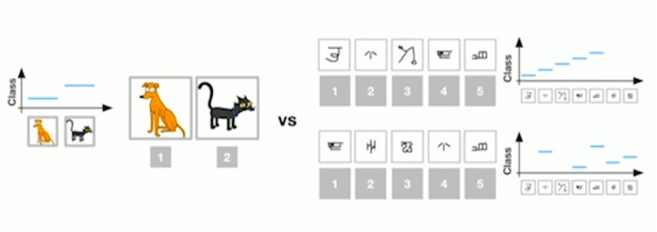
Meta-Learning Algorithms
Example: Few-shot classification
Traditional learning
Few-shot learning
Images can have random labels, and each sample in next instance will have different labels
Notes:
few-shot learning refers to the practice of feeding a learning model with a very small amount of training data, contrary to the normal practice of using a large amount of data. This technique is mostly utilized in the field of computer vision, where employing an object categorization model still gives appropriate results even without having several training samples
Minimalist datasets

Slide 3
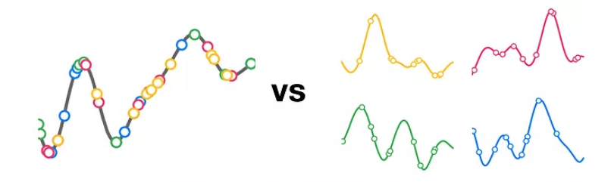
Few-Shot Classification
Traditional learning
Few-shot learning
System that learn whole distribution over functions by seeing different function at every instance
At test time, they narrow down to a function by picking few context observations
Learns a single underlying function from several observations during training
Notes:
Aim: A model that can regress distributions over functions

Slide 4
Abstract:
Deep neural networks excel at function approximation, yet they are typically trained from scratch for each new function. On the other hand, Bayesian methods, such as Gaussian Processes (GPs), exploit prior knowledge to quickly infer the shape of a new function at test time. Yet GPs are computationally expensive, and it can be hard to design appropriate priors. In this paper we propose a family of neural models, Conditional Neural Processes (CNPs), that combine the benefits of both. CNPs are inspired by the flexibility of stochastic processes such as GPs, but are structured as neural networks and trained via gradient descent. CNPs make accurate predictions after observing only a handful of training data points, yet scale to complex functions and large datasets. We demonstrate the performance and versatility of the approach on a range of canonical machine learning tasks, including regression, classification and image completion.
Notes:
Netflix: tv shows, movies matching

Slide 5
Regression algorithms
Neural Networks
Gaussian Processes

Slide 6
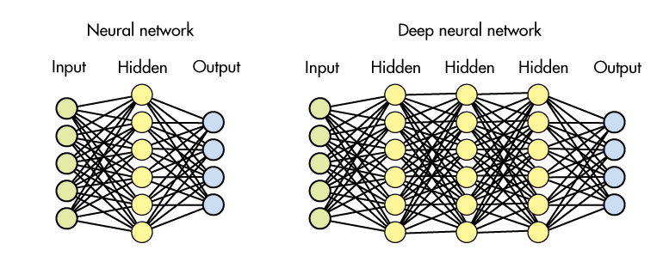
Neural Networks
Set of algorithms, modeled loosely after the human brain, that are designed to recognize patterns. They interpret sensory data through a kind of machine perception, labeling or clustering raw input.

Slide 7




Introduction: Examples of where NN are used
Photo Search
Tagging Algorithm
Home Feed Personalization
Product Recommendation
Notes:
Netflix: tv shows, movies matching

Slide 8
Deep Neural Network
Also known as deep structured learning or hierarchical learning.
Is part of broader family of machine learning methods based on Artificial Neural Networks. Learning can be:
Supervised: It infers a function from labeled training data consisting of a set of training examples
Unsupervised: Self-organization and allows modeling probability densities of given inputs
Semi-supervised: Makes use of a small amount of labeled data with a large amount of unlabeled data (targets)
Notes:
ANN: inspired but not neccesarily identical to human brains.
work without previous knowledge
try to identify images that contain say an animal by analyzing example images that have been manually labeled
Supervised: intends to infer a conditional probability distribution
pX(x|y) conditioned on the label y of input data
Unsupervised learning intends to infer an a priori probability distribution
pX(x)

Slide 9
Deep Neural Network: How it works
Uses multiple layers to progressively extract higher level features form raw input.
For example: In image processing, lower layers may identify edges, while higher layers may identify human-meaning items such as digits/letters or faces.
Notes:
Supervised: intends to infer a conditional probability distribution
pX(x|y) conditioned on the label y of input data
Unsupervised learning intends to infer an a priori probability distribution
pX(x)

Slide 10
Deep Neural Network: How it works
The network moves through the layers calculating the probability of each output.
For example:
A DNN that is trained to recognize dog breeds will go over the given image and calculate the probability that the dog in the image is a certain breed.
The user can review the results and select which probabilities the network should display (above certain threshold) and return the proposed label.
Each mathematical manipulation is considered a layer.
Notes:
Complex DNN have many layers, hence the name "deep" networks.
Recurrent neural networks: in which data can flow in any direction, are used for applications such as language modeling. Long short-term memory is particularly effective for this use.
Convolutional deep neural networks (CNNs) are used in computer vision and automatic speech recognitiion

Slide 11
Deep Neural Network: Challenges
Overfitting: Occurs when a model begins to “memorize” training data rather than “learning” to generalize from a trend
Computation Time: Optimal parameters may not be feasible due to the cost in the time and computational resources
Large data sets for effective training: Must consider many training parameters, such as the size (number of layers and number of units per layer), the learning rate and initial weights

Slide 12
Deep Neural Network: Challenges
The first phase learns the statistics of a generic domain, drawing a large training set, but without committing to a specific learning task within that domain
The second phase learns a function for a specific task, but does so using only a small number of data points by exploiting the domain-wide statistics already learned
Meta-Learning
Scalable and successful at learning features and prior knowledge from the data directly
Notes:
Meta-Learning:
Implements Generative Query Networks that learn to do few-shot estimations of the underlying density of the data refers to the practice of feeding a learning model with a very small amount of training data
Classification

Slide 13

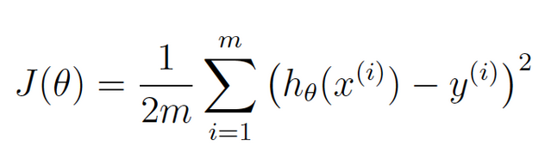

Gradient Descent
Gradient descent is a first-order iterative optimization algorithm for finding the minimum of a function.
To find a local minimum of a function, steps are taken proportional to the negative of the gradient of the function at the current point.
For a hypothesis given by a linear model: , regression minimize the cost function
The values are updated during each iteration, s.t. parameter θ comes closer to the optimal values that will achieve the lowest cost
For a more understanding, lets go to the notebook

Slide 14
Gaussian Processes
A Gaussian Process is a set of random variables, any finite combination of which have (consistent) Gaussian Distributions
A Gaussian distribution is fully specified by a mean vector, 𝞵 and covariance matrix 𝝨:
f = (f₁, f₂, …, f_{n}) ~ Ɲ (𝞵, 𝝨), indices i = 1, 2, … n
A Gaussian process is fully specified by a mean function, m(x) and covariance function K(x, x’):
f(x) = GP ( m(x), K(x, x’) ), indices x
For a concrete understanding, lets go to the notebook.

Slide 15
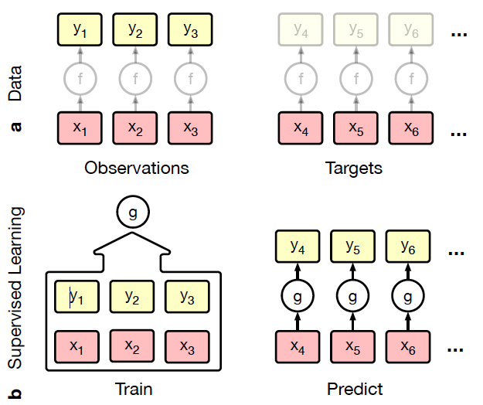
Supervised Learning
Observations: O = { (x_{i},y_{i}) }^{n-1} _{i=0} ⊂ X × Y pairs
with x_{i} input , y_{i}=f(x_{i}) output s.t. f : X → Y
Targets: T= { (x_{i}) }^{n+m-1} _{i=n} ⊂ X
NN: Randomly initialize g for each new task. Prior information about f is specified via g, the loss function or training details
GP: Use Bayesian inference over the functional space conditioned to the observed values. Prior information about f is specified via K(x,x’) and g is a random function according to the predictive posterior dist.
Computationally limited: scales as O( (n+m )³ )
Prior knowledge is limited
Notes:
Targets:We call these unlabelled data points targets. Classification, regression, dynamics modeling, and image generation can all be cast in this framework.
Supervised: Prior information that a practitioner may have about f is specified via the architecture of g.
The extent of prior knowledge that can be expressed in this way is relatively limited,
and learning cannot be shared between different tasks,
the amount of training required is large, and deep learning methods tend to fail when training data is not plentiful.

Slide 16
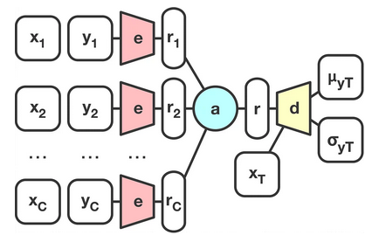
Conditional Neural Processes
Pass the observed data (x_{i},y_{i}) to an encoder, to obtain individual representations r_{i}
Aggregate all the representations together to obtain a main representation r
Use r in combination with target data point x_{T} and pass it through the decoder, that outputs mean prediction and its variance
Once r is computed, arbitrary number of target points can be passed in parallel => run time is linear than quadratic
The mean and variance are used to calculate the log-likelihood of the ground truth data and use that to update the model
The process is done for every function corresponding to different subset of points in the dataset, hence model learns the whole distribution of the functions
forward pass
Encoder: MLP with a handful of layers and is shared between all the context points
Decoder: MLP with a handful of layers and is shared between all the target points
Notes:
r has all information about the current function given the observations
the mean is by itself a useful prediction, and that the variance is a good way to capture the uncertainty
Like GPs, NPs define distributions over functions, are capable of rapid adaptation to new observations, and can estimate the uncertainty in their predictions.
Like NNs, NPs are computationally efficient during training and evaluation but also learn to adapt their priors to data.

Slide 17
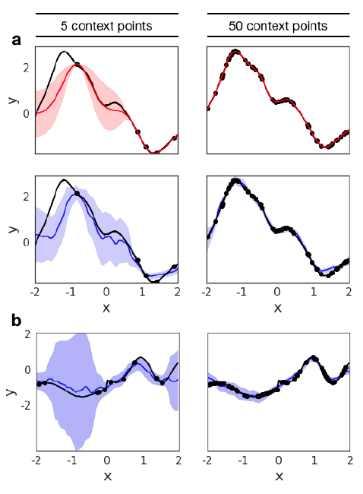
Experimental Results: Regression
GP
Single underlying Kernel
x and y are the predicted mean and variance of the regression
CNP
Switching Kernel parameters
CNP

Slide 18
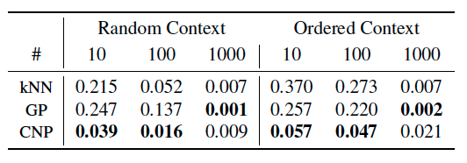
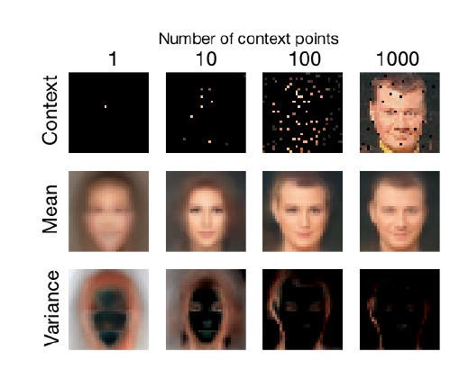
Experimental Results: 2D Regression
With x₁ and y₁ being the pixel position and color, one can pick come context points, and predict the image at a target point
With increasing context points, the accuracy in mean prediction of the CNN model increases with decrease in variance
The context points are chosen either at random or ordered from the top-left corner to the bottom-right.
With fewer context points CNPs outperform kNNs and GPs.
In addition CNPs perform well regardless of the order of the context points, whereas GPs and kNNs perform worse when the context is ordered.
Notes:
we choose images as our dataset because they constitute a complex 2-D function that is easy to evaluate visually
The input x is the 2D pixel coordinates normalized
The output y is either the grayscale intensity or a vector of the RGB intensities of the corresponding pixel.
The model and training procedure are the same for both: we select an image from the dataset and pick a subset of the pixels as observations.
Conditioned on these, the model is trained to predict the values of all the pixels in the image (including the ones it has been conditioned on).
forces the model to not only predict pixel values according to some stationary smoothness property of the images, but also according to global spatial properties, e.g. symmetry and the relative location of different parts of faces.
mean squared error for all of the pixels

Slide 19
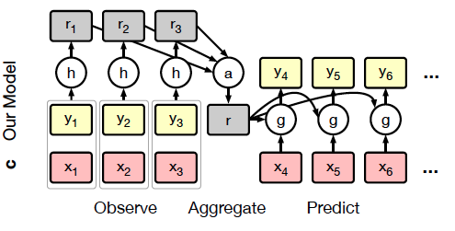
Summary
A CNP is a conditional distribution over functions trained to model empirical conditional distributions of functions f ~ P ( f(T) | O,T)
The dependence of a CNP on observations is parameterized by a NN that is permutation invariant in O and T
A CNP is scalable to O(n+m)
Notes:
h is batch gradient descent

Slide 20
More Info
https://github.com/deepmind/neural-processes
https://medium.com/intuitionmachine/is-conditional-logic-the-new-deep-learning-hotness-96832774907b
https://skymind.ai/wiki/neural-network

Slide 21
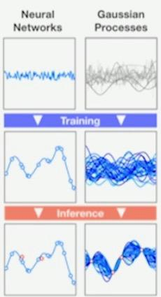
NN vs GP
Learn function approximation from data directly
Using prior, learn distribution over functions -> Flexible at test time
Can model complex functions with few functional restrictions
Have a measure of uncertainty on the prediction given observations are test-time
Fast evaluation at test time
Notes:
GP:
Using prior learn distribution over function
At inference time take some observations and narrow down the belief on the ground truth function

